Slide 1


NEXT GEN EMPLOYABILITY PROGRAM
CREATING A FUTURE-READY WORKFORCE
Student Name :
ABHISHEK K
Student ID :
College Name :
STU678f727ceb5f31737454204
GLOBAL ACADEMY OF TECHNOLOGY

Slide 2
CAPSTONE PROJECT SHOWCASE
Project Title
A Service for Delivering Food (Zomato Clone) with MERN Technology
Abstract | Problem Statement | Project Overview | Proposed Solution | Technology Used | Modelling & Results | Conclusion | Q&A

Slide 3
Abstract
1
The Food Delivery Application is a web-based platform that allows users to browse menus, place orders, and track deliveries in real time.
2
It leverages the MERN stack (MongoDB, Express.js, React.js, and Node.js) to ensure seamless functionality and scalability.
3
The platform incorporates secure user authentication, restaurant management, and an efficient order processing system.
4
This project aims to provide an intuitive and robust solution to improve the food delivery experience.

Slide 4


Problem Statement
With the rise in demand for online food delivery services, many existing platforms face challenges such as inefficient order management, high delivery time, and limited restaurant options. There is a need for a robust and user-friendly food delivery application that provides a seamless ordering experience, real-time tracking, and efficient restaurant management.

Slide 5

Project Overview
The Food Delivery Application (Zomato Clone) allows users to explore a variety of restaurants, select food items, and place orders effortlessly. Restaurants can manage their menus and orders efficiently.
Key features include:
User Authentication: Secure login and registration.
Restaurant Management: Add, update, and remove restaurant details.
Order Placement & Tracking: Real-time order updates and tracking.
Admin Dashboard: Manage users, restaurants, and orders.

Slide 6
Proposed Solution
To address the existing challenges in online food delivery, this application incorporates:
A responsive user interface built with React.js for seamless navigation.
Backend services using Node.js and Express.js to handle requests efficiently.
MongoDB for a scalable database structure to store user, restaurant, and order details.
JWT-based authentication for secure access control.
WebSocket for real-time order status updates and tracking.

Slide 7
Technology used
Frontend: React.js, HTML, CSS, Bootstrap
Backend: Node.js, Express.js
Database: MongoDB
Real-time Updates: WebSocket
Hosting & Deployment: Vercel (Frontend), AWS/Heroku (Backend)

Slide 8
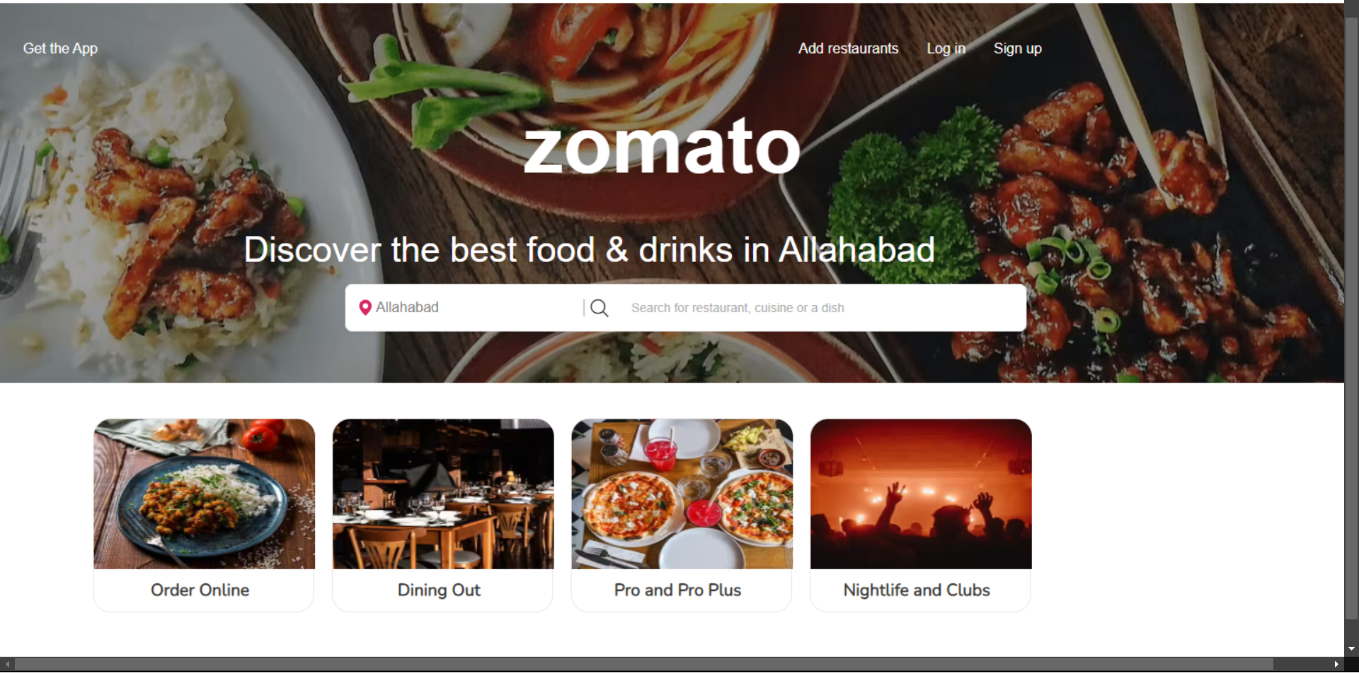
Modelling & Result

Slide 9
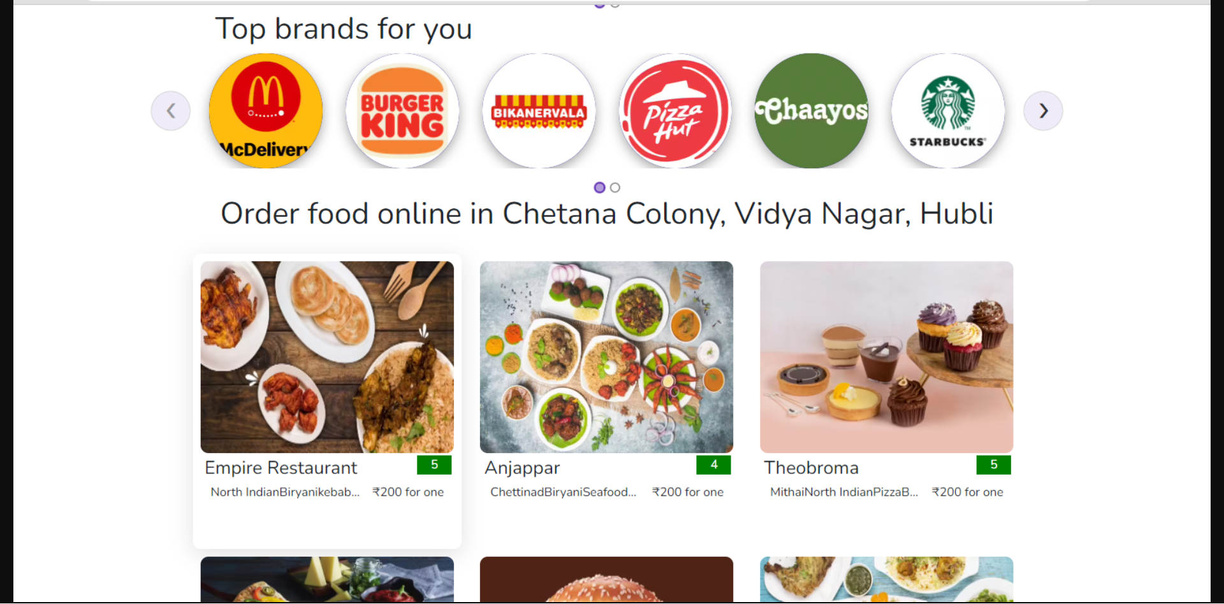
Modelling & Result

Slide 10
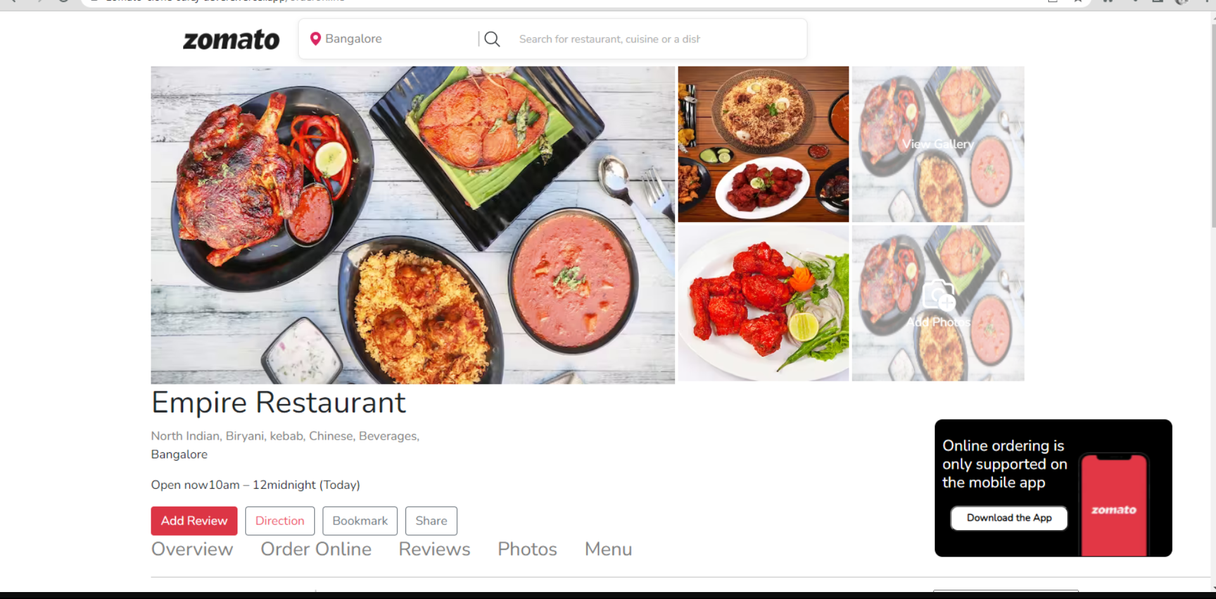
Modelling & Result

Slide 11

Conclusion
This project successfully demonstrates the development of a scalable and efficient food delivery application using the MERN stack. The platform offers a user-friendly interface, seamless restaurant management, and a secure ordering system. Future enhancements may include AI-driven recommendations, a loyalty program, and integration with delivery partners for automated dispatching.

Slide 12
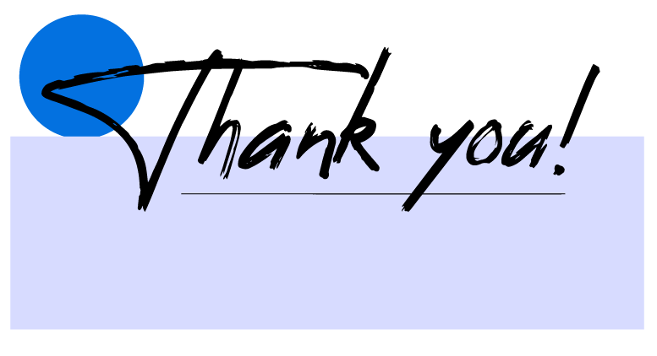

Notes:
Thank You !!

